Slide 1
Experiential Disruption
Trends in Experiential Learning, WIL and beyond…

Slide 2
Outline
Trends to set context
Challenges with scale
Tech Disruptors
Demo
Notes:
In this presentation I’ll first set some context by looking at the challenges of WIL @ scale, then explore the technology-based disruptors to the current approaches and finally look at what the future contains based on engagement with educators at the forefront.

Slide 3
Trends

Slide 4
Scale
2025
2014
1,000,000+ international students
400k HE
300k VET
300k ELICOS
This is probably low
400,000+ international students
230k HE
110k VET
115k ELICOS
10% avg annual growth

Slide 5
Why Experiential?
Resume → Network
Credential → Narrative
Students: experiences that build networks and narratives
Employers: more value, less hassle in participation
Educators: assure quality & control costs at scale
Notes:
Scale – online, global – whereever the brand is extended
It’s not what you know… but It’s not who you know any more either… because we all know each other
But how who you know can connect and influence are important – so network QUALITY is essential
What you can do is most important…
How well do you learn from mistakes?
Can you tell a good story?
I lost $1m in the first hour of my first internship
Can you get people excited? Inspired?
Can you teach us something new? Bring in a new view point?

Slide 6
The Experiential Opportunity
Future Education
Current Education
40% How
40% Why
20% Who, What, When. Where
Learn while Doing
70%+ Who, What, When, Where
20% How
10% Why
Learn then Do
Notes:
How does it work, how did I feel, how did they feel?
Why do these things work/not work in practice?
MUCH MORE REFLECTIVE

Slide 7
Current State
Ambitious VCs
Work Experience vs. WIL
Fair Work

Slide 8
Future Work Skills
Talent in a Digitized World
Notes:
Write down 3 questions you have

Slide 9
Past
Earning Power
Knowledge Capability Requirement
Present > Future
Earning Power
Knowledge Capability Requirement

Slide 10
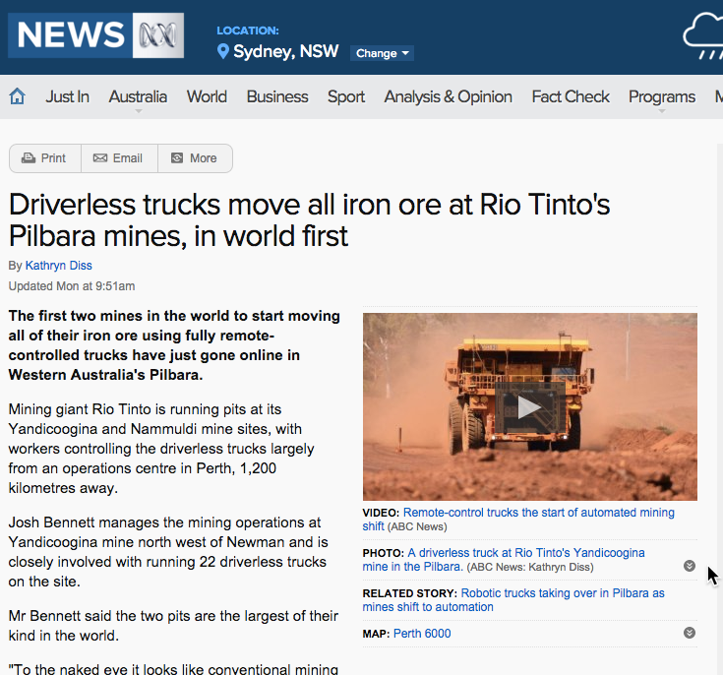
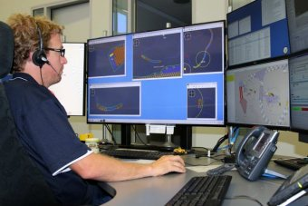
Notes:
Miner = problem solver

Slide 11
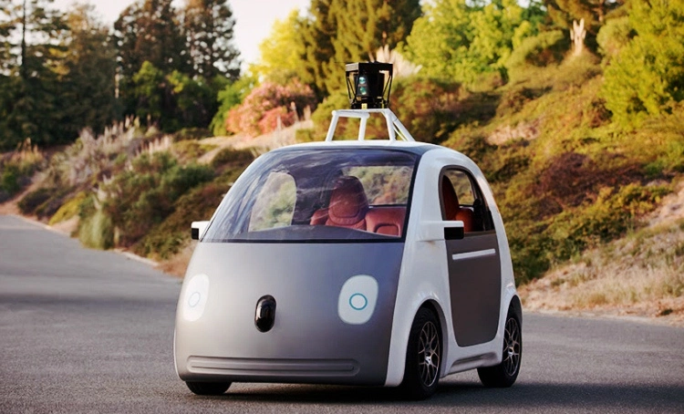
Notes:
Taxi driver = tour guide

Slide 12


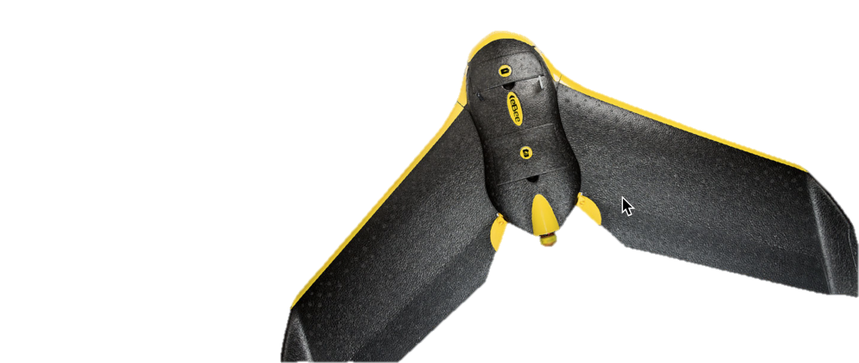
Notes:
Farmer = drone operator, data analyst

Slide 13
Digitization of work
Much Harder to Automate
Tech Can Automate
Interpersonal Tasks
Drawing Insights
Inconsistent/Variable Tasks
Creative Tasks
Abductive
Value in Process
Physical Tasks
Data Gathering & Reporting
Repetitive Tasks
Precision Tasks
Inductive/Deductive
Value in Outcome
Notes:
Oxford study: 47% of jobs today under threat from automation soon.

Slide 14
Future Jobs
Digital Curator contextual relevance
Emotive Pattern Seeker discover inspiring
Integrator connect knowledge, tech
Gap Filler arbitrage tech evolution

Slide 15
The Additive Value of Employability Skills
Leadership
Entrepreneurship
UX
Value Adding
Pattern Seeking
Project Management
Multi-cultural relations, virtual collaboration
Digital Savvy (Creation and Consumption)
Teamwork, Communication
Reflection, Goal Achieving, Resilience
Creativity, Structured problem solving, Scientific method

Slide 16
Scale Challenges
Or – why disruption is the only way

Slide 17
WIL@scale challenges
Quantity of appropriate opportunities
Support during delivery
Assurance of relevant learning
Industry participation cost/benefit
Notes:
Many educators are trying to greatly increase WIL participation levels. But providing meaningful WIL at scale is very difficult.
The next slides will explore three major issues we regularly see with providing quality WIL at scale.

Slide 18
Quantity
SME engagement
Microprojects
Digital native WIL
Notes:
Research shows that the biggest factor in student satisfaction is the perception and level of support. But WIL is notoriously difficult to support. Many students don’t know that they’re struggling, or why they’re struggling because so many aspects of the experience are ambiguous and new. Other students want to have their hands held at every intersection and struggle with embracing the uncertainty. The result for many educators is substantial time spent upfront during program setup and then a overflowing river of problems near the end of the experience when it’s too late to fix them.
Creating a capability to deliver support “just in time” means having granular visibility of the progress of all participants during the experience. To do this, the experience
needs to be structured in a way that gathers relevant data frequently, without the data gathering process detracting from the experience.
The problem is exacerbated with business internships. Often educators are managing students placed in dozens of companies. Each company has a different project and way of managing that student’s project. The educator might provide some tools for the employer, but they’ll only use them inasmuch as the tools fit within whatever they were planning on doing anyhow. This creates high variability between experiences, which is a support nightmare.

Slide 19
Support
Just-in-time vs crisis time
Getting lots of the “right” data
Minimising variability
Notes:
Research shows that the biggest factor in student satisfaction is the perception and level of support. But WIL is notoriously difficult to support. Many students don’t know that they’re struggling, or why they’re struggling because so many aspects of the experience are ambiguous and new. Other students want to have their hands held at every intersection and struggle with embracing the uncertainty. The result for many educators is substantial time spent upfront during program setup and then a overflowing river of problems near the end of the experience when it’s too late to fix them.
Creating a capability to deliver support “just in time” means having granular visibility of the progress of all participants during the experience. To do this, the experience
needs to be structured in a way that gathers relevant data frequently, without the data gathering process detracting from the experience.
The problem is exacerbated with business internships. Often educators are managing students placed in dozens of companies. Each company has a different project and way of managing that student’s project. The educator might provide some tools for the employer, but they’ll only use them inasmuch as the tools fit within whatever they were planning on doing anyhow. This creates high variability between experiences, which is a support nightmare.

Slide 20
Assurance
Employers must believe
Effort ≠ Outcomes
Different Strokes for Different Folks
Notes:
The majority of students are not going to be facing journal review councils – they’ll be facing an HR team and interviewers for a job. If “assurance of learning” does not align with employer perceptions there’s a long-term risk of brand devaluation. A student getting a High Distinction in an experiential program should be seen by an employer as having outstanding demonstration of the skills that were emphasised during the unit. At the moment, there is no such correlation and as a result many employers place little value on university experience.
Experiential programs struggle with whether to assess on outcomes or effort. Both are important metrics. Combining into a single “score” does not help a prospective employer. Employers would evaluate high effort/high outcome students differently than low effort/high outcome performers, even though both might get Distinctions. Even more troubling, in some situations a high effort/low outcome student might also end up with a Distinction.
Each student also will have different learning needs for a given experiential program. One might be weak on teamwork, another weak on presentation skills. It is currently rare to see “personalised” experiential programs where students, educators and experience providers select the competencies that the student needed to develop up-front and the assessments would adjust to track those specific needs.

Slide 21
Industry Benefit
Employability
Time vs. Output
Capacity
Notes:
The appetite for traditional “interns” is diminishing. Larger employers are scaling back their graduate recruitment programs. They are also cutting back on internal training of “soft skills” for new hires, preferring to hire those who already have demonstrated these capabilities. There are also attractive competing alternatives –why take an intern when you can get a team of MBA students as free consultants. For international students, it’s even worse. Many employers put international interns into the “too hard” bucket, under the belief that they are either not employable or too expensive to employ.
Even if an intern has many “work-ready” skills, they’ll require on-boarding before they can fit into existing project workstreams. This requires someone in the business to put aside their work for the benefit of the intern. For businesses without dedicated graduate recruitment teams (e.g. most Australian Small to mid-sized enterprises) this is either too hard or done at the transactional level, where the intern has no opportunity for applying or developing any formal skills.
The result is a disconnect between the potential for WIL opportunities and the actual availability of opportunities. As a result, only 25% of Australian students have a work experience during each year of their education, compared to 60% of Americans, where smaller student numbers and stronger alumni networks connect with small/mid-size businesses to create a larger availability of work experience opportunities. A MUCH lower minimum wage also helps.

Slide 22
The Disruptors

Slide 23
Tech Disrupting Education
Social Learning
Gamification
Mobile First
Marketplaces
Project Learning
Notes:
Social learning uses collaboration tools to get students to create a communal experience where students help each other and educators simply guide and facilitate the learning process. In the extreme cases, the students are recreating the educational content in their own terms and language. See https://spoonfeedme.com.au/ for an example of students preferring to get the lesson explained by a prior year’s “top” student than the lecturer.
Gamification adds competitiveness to the learning process. The student is motivated to acquire a series of badges or achievements – perhaps for bragging rights or because they confer some extra benefits either within or beyond the course. The “game design” approach is also highly applicable to experiential learning. Often in games you learn by failing and then starting over or reversing a bit. Good experiential programs provide opportunities to fail safely, adapt and try again.
Project learning takes the position that most WIL can be modeled as a “project”, from a project management/consultancy perspectives. There are milestones, activities, deliverables and evaluations. In a project learning approach the activity is the focus and the “content” is a supporting resource to help achieve an outcome. For example, a Project Plan milestone might have a “Team Charter” activity which is supported by topical content such as teamwork, collaboration, dispute resolution, etc. Rather than “quizzes” with right/wrong, there are simulations which test the ability to apply the learning.

Slide 24
What are we doing?
Helping educators increase the amount of experiential learning
Helping employers get more value out of participation
Using technology to enable scale

Slide 25


Intersective helps educators, employers and students achieve better outcomes from experiential learning collaboration
Program design and management services
Experiential learning platform
Notes:
My co-founder and I left Deloitte soon after delivering a successful pilot of a large scale WIL program with the University of Sydney. We founded Intersective and Deloitte and the University became our first customers – and still are.
Intersective today provides technology and services to help deliver better experiential learning outcomes for all parties;
Practera is a world first, evidence based ‘project learning’ platform, deployed with over 4000 paying learners, mentors and educators, enabling ‘virtual’ experiential learning, close to deployment as a SaaS product, opening up global potential
Intersective delivers advisory services and brokers and manages experiential learning programs built on Practera with its high-calibre team of industry, academic and entrepreneurial experts
Intersective has an experienced founder and management team with technology / business skills, patented, unique technology, ~$1.75M in revenue run rate, R&D tax grant approval, and high quality repeat customer base
We started off as a Services business and built technology to help us deliver better outcomes, track experience and provide quality assurance analytics to all participants. That technology is now the focus of our business and is called Practera.
Let me give you some insight into Practera and what it does…

Slide 26



























Customers & partners
Educators
Connectors
Employers

Slide 27



What Outcomes can we improve?
Students
- Provide support, structure, reduce ambiguity
- Build networks and narrative
Educators
Simplify onboarding, setup and delivery -
Quality Assurance of learning -
Host organizations
- Improve clarity of commitment
- Sustainable, scalable
-

Slide 28
Improving Student Outcomes

Slide 29
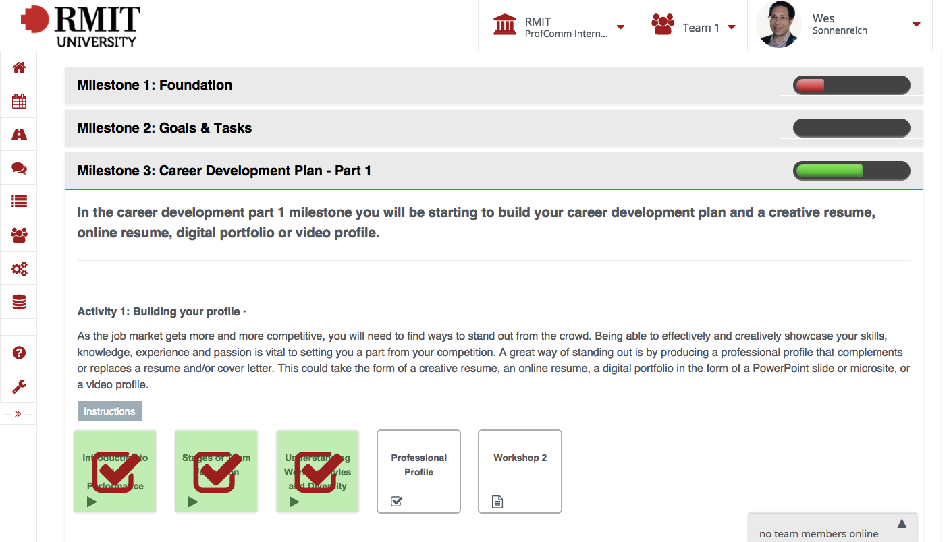
“Project” structure drives action and reflection

Slide 30
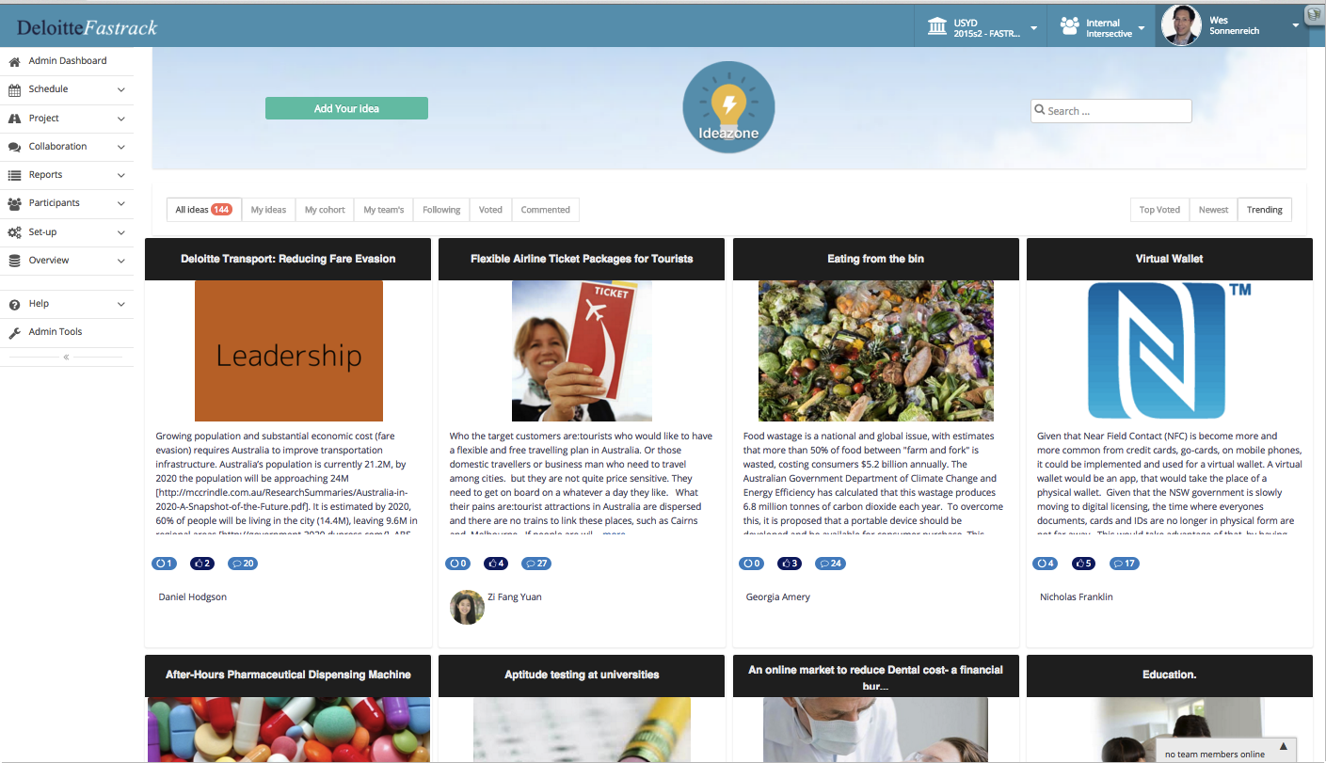
Collaboration that feels like social media

Slide 31
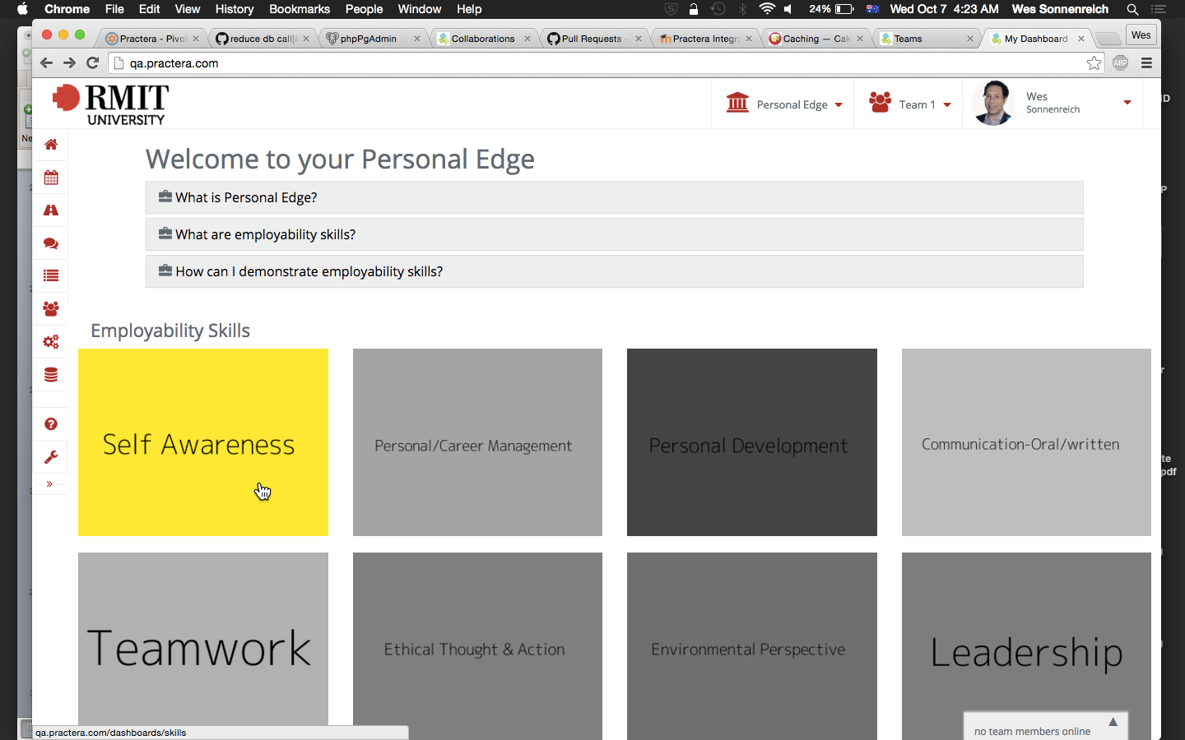
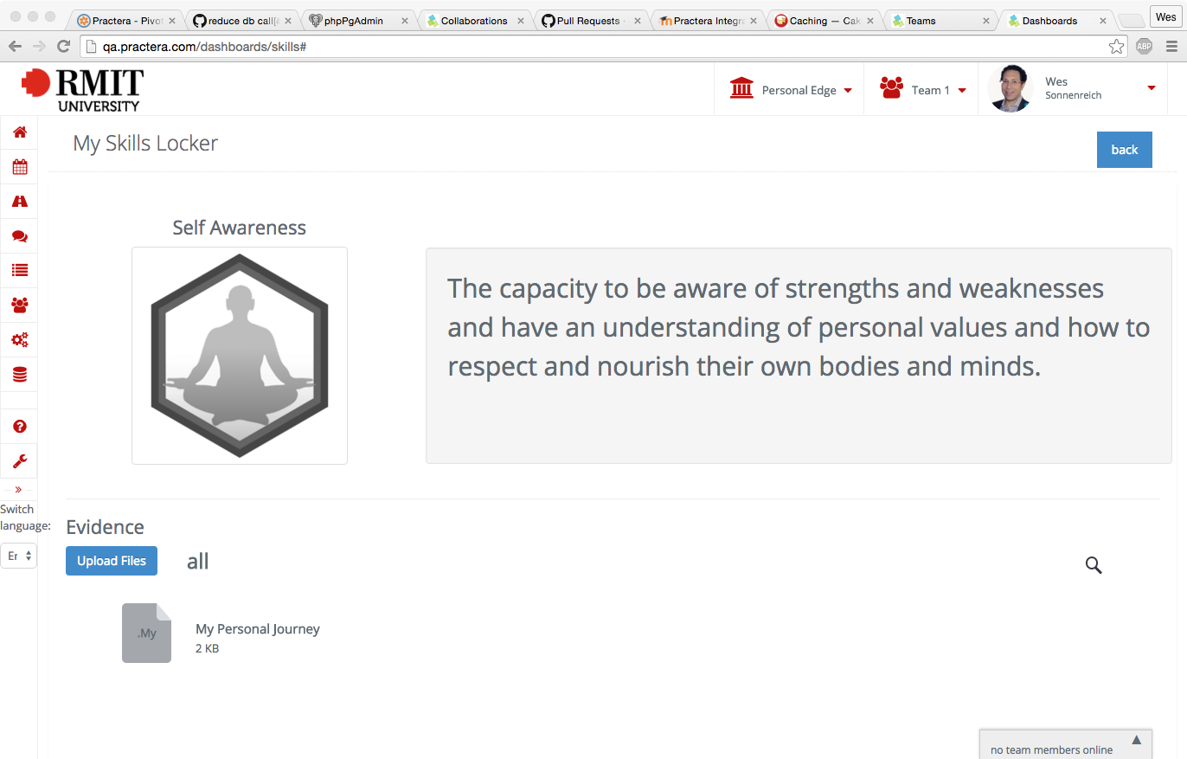
Connects project work & reflections to skills

Slide 32
Improving Educator Outcomes

Slide 33
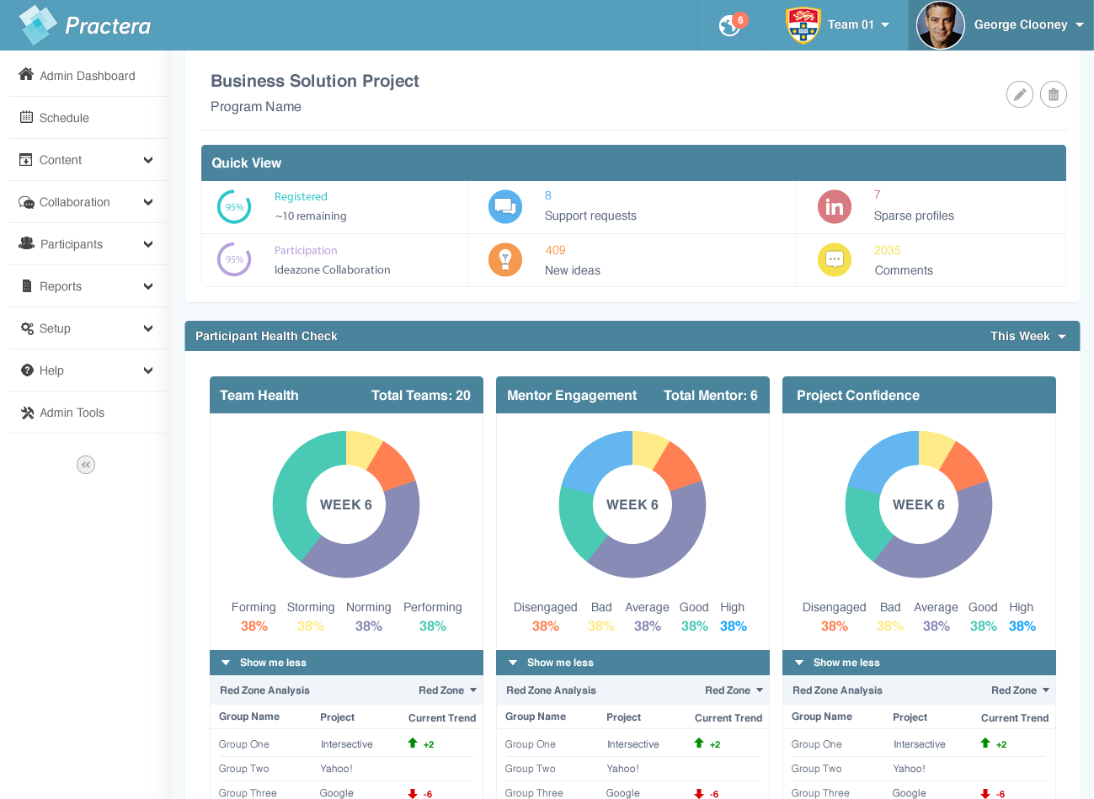
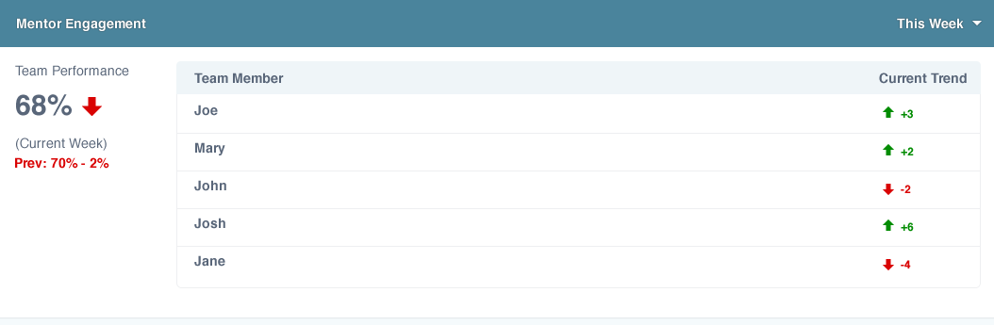
QA with Real-time data on participant experience
Notes:
Sentiment Analytics

Slide 34
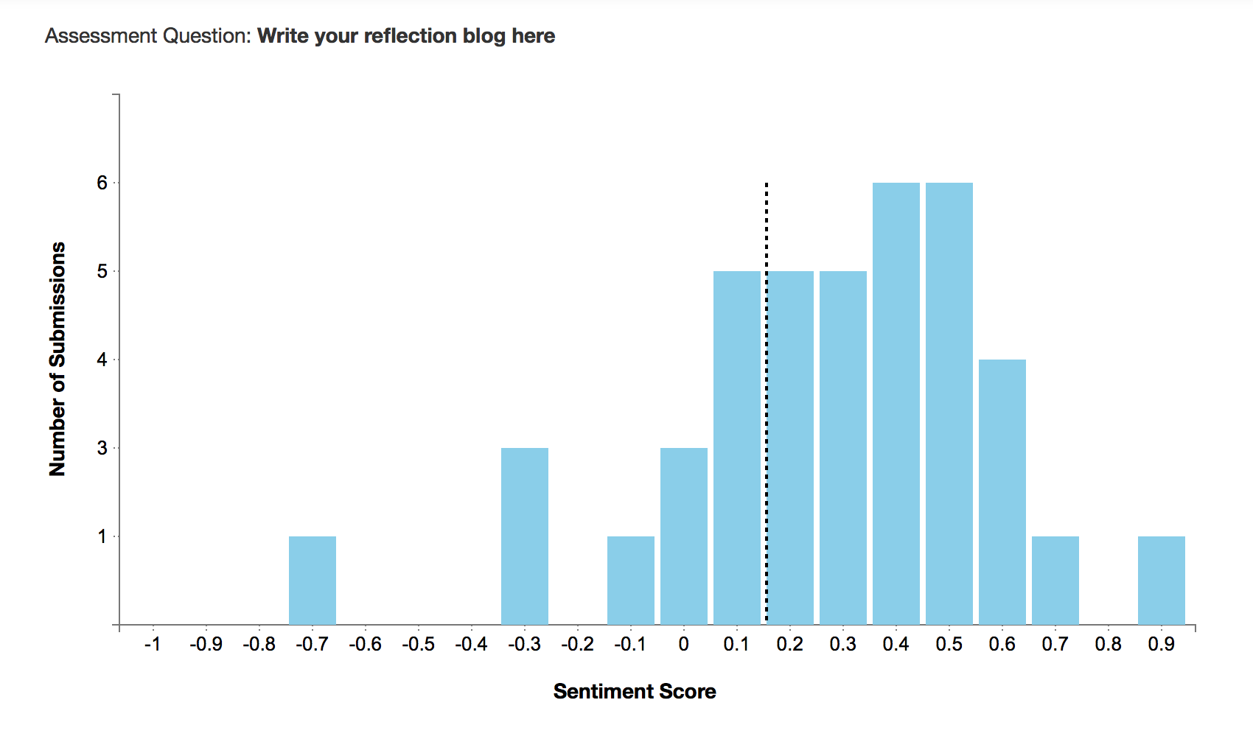
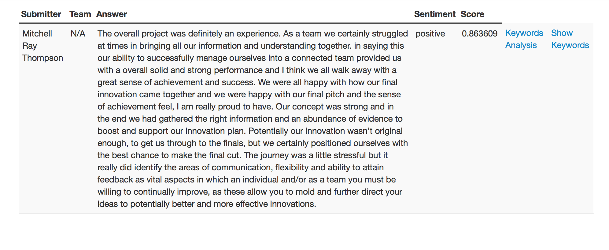
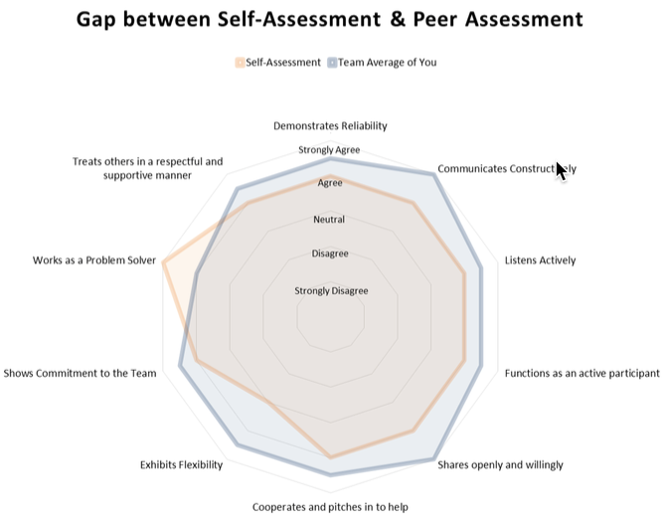
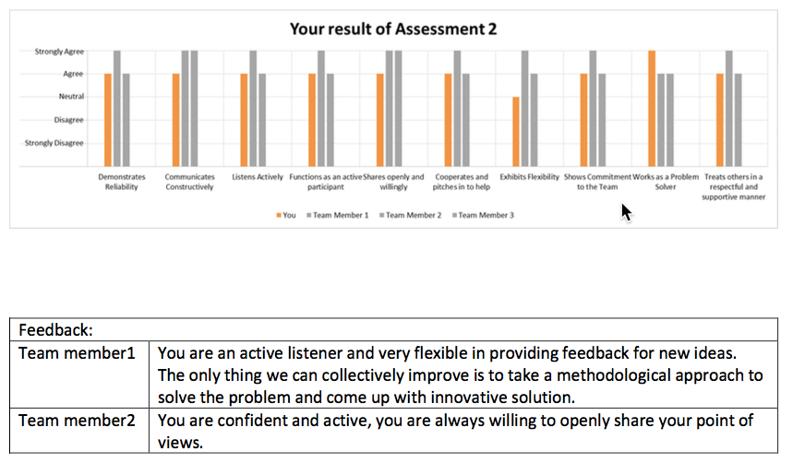
Automated Analytics enables more reflection, feedback

Slide 35
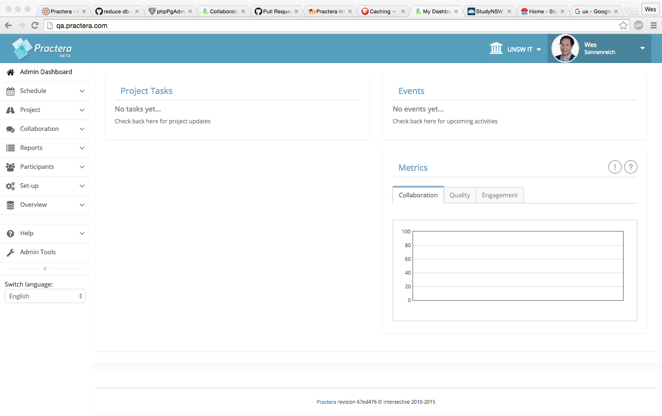
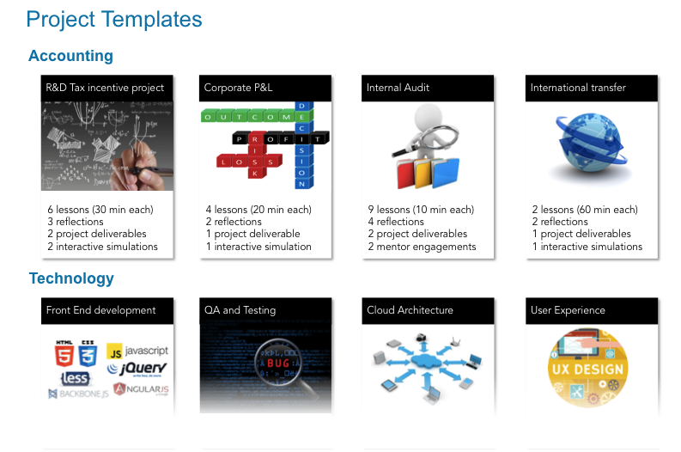
Project templates speed up setup & host onboarding

Slide 36
Improving Employer Outcomes

Slide 37
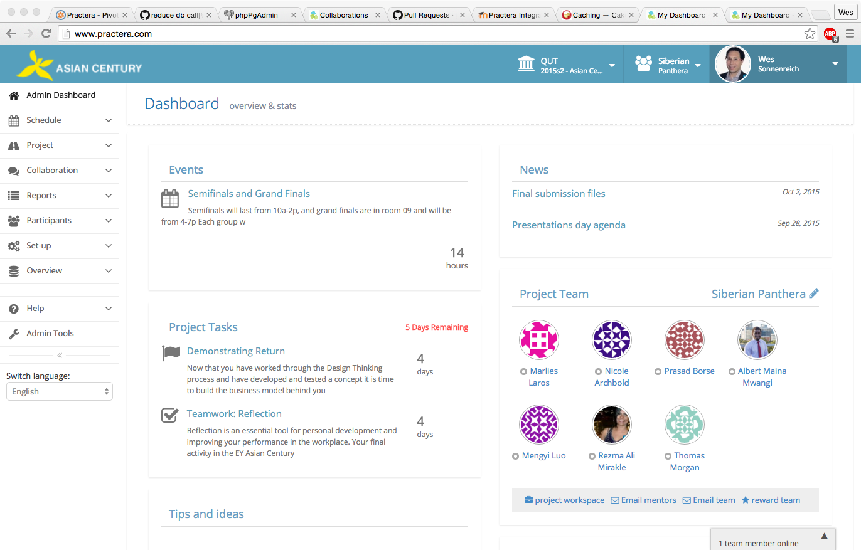
Clarity of time commitment, expectations

Slide 38
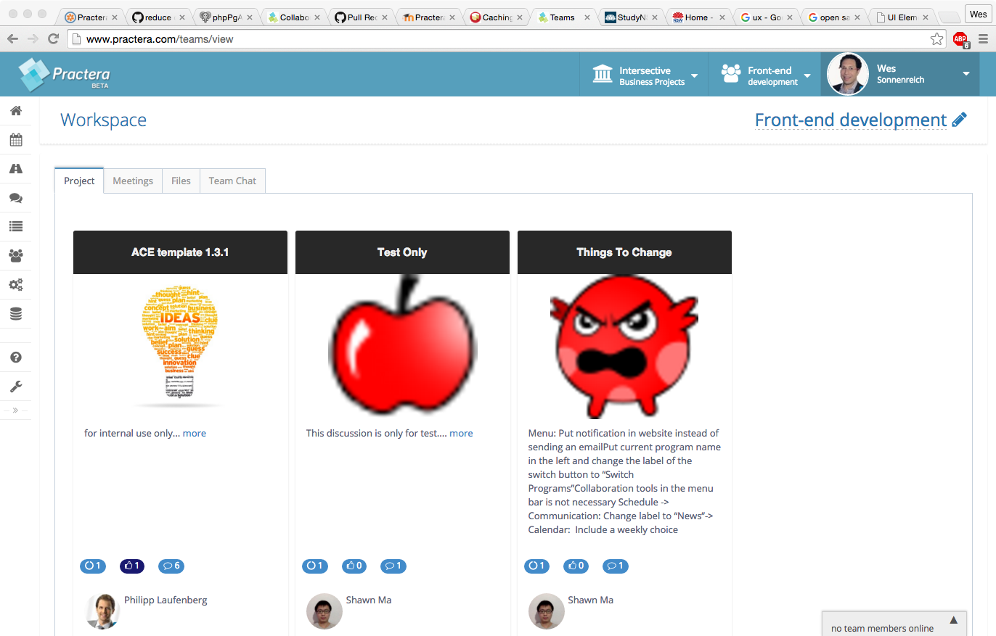
Project Handover, Knowledge Management

Slide 39



Deploying Practera as an internship management system for Performance Education’s intern placement business supported by a Commonwealth Government Accelerating Commercialisation grant

Slide 40







The pilot project will offer up WIL experience to 300 students in the NSW public sector, with potential to scale the program to include thousands of students every year...

Slide 41
Thankyou
Wes Sonnenreich
CEO, intersective
wes@intersective.com
+61 410 366 289

